Slide 1

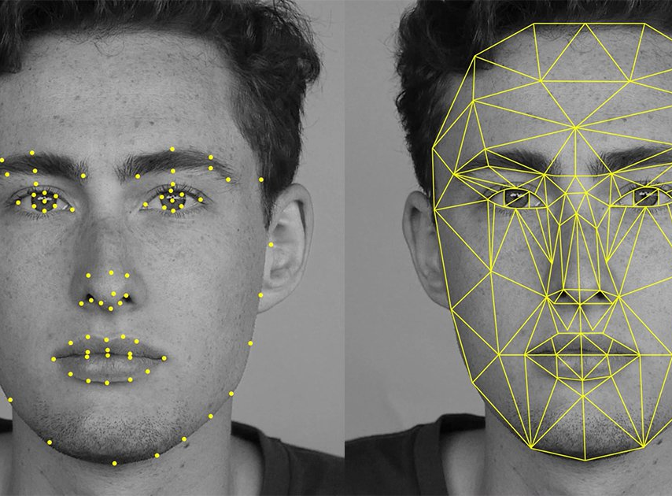

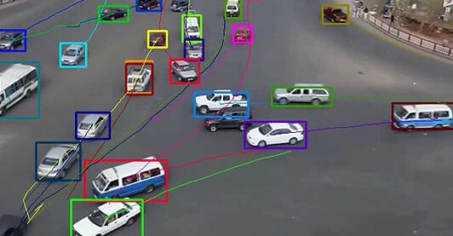
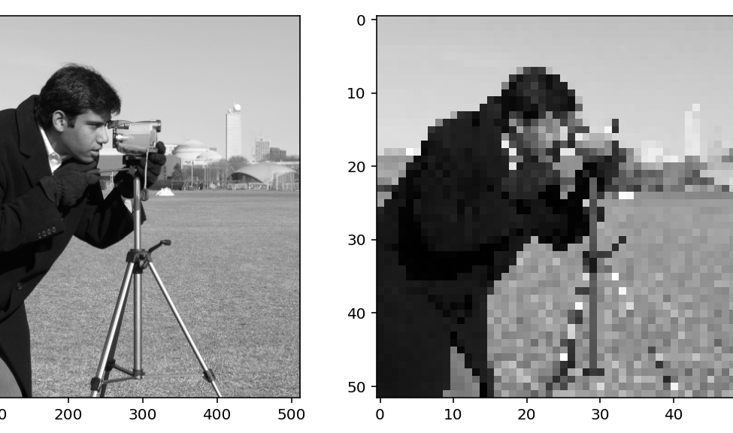
ECE 1390/2390 Image Processing and Computer Vision

Slide 2
About this course
Course number 1390 (40 students)
Course number 2390 [Graduate level] (20 students)
graduate level will have harder problem sets and more involved project goals

Slide 3
About this course
Learning Objectives:
Introduction to image processing methods including data structures, filtering, enhancement, transforms, and homography.
Introduction to computer vision through OpenCV and Python including object detection and tracking methods, segmentation, digital photography, and in-painting.
Hands on learning through group project. How to use GitHub for collaborations, push requests, peer-review, and code checks

Slide 4
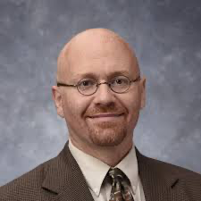
Who am I?
Instructor: Ted Huppert, PhD;
Associate Professor (ECE)
Dept of Radiology (2007-2019)
Dept of ECE (2019-current)
Email: huppert1@pitt.edu
Office: BEND 1238L (in 12th floor ECE admin area)
Office hours: M/W 3:30-4:30
https://calendly.com/huppert1

Slide 5
Who am I?
Teaching Instructor:
Yang Du
yang.du@pitt.edu
Office hours by request.

Slide 6
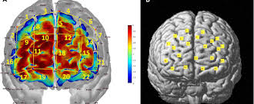
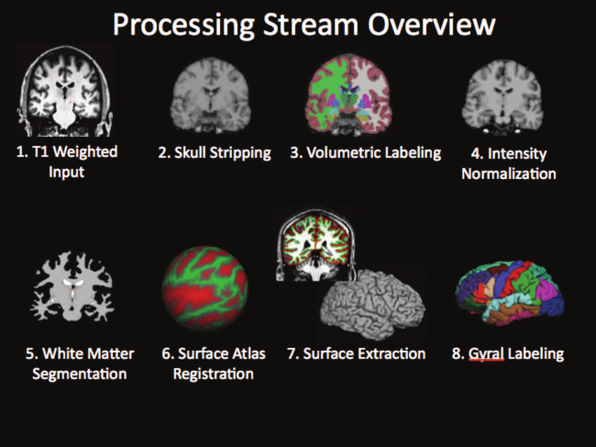
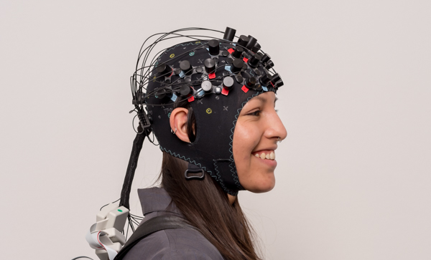
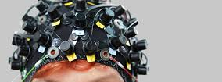
M³(NI)² Lab
Multimodal Methods in Noninvasive Neuroimaging Lab
www.huppertlab.net

Slide 7
Organization of Course
Monday & Wednesday 4:30 – 5:45pm
1211 BEND
Lectures (PowerPoint & Python Notebooks)
Materials will be provided on Canvas
No required textbook for course
Classwork (60% of grade)
Practical examples done in Python/OpenCV
Semester project (30% final; 10% peer-ratings).
No midterm or Final exams

Slide 8
Grading Scale:
Homework 60% [12 x 10 points each]
Semester Project Peer scores 10% [20 pts]
Final Semester Project 30% [60 pts]
------------------
Total 200 points
[98 - 100) A+ [88 - 90) B+ [78 - 80) C+ [68 - 70) D+
[92 - 98) A [82 - 88) B [72 - 78) C [62 - 68) D
[90 - 92) A- [80 - 82) B- [70 - 72) C- [60 - 62) D-
<60: F

Slide 9
Syllabus
Week | Date | Topic | In class work | Due date
1 | 8/25/2025 | Introduction to course | Intro to OpenCV (HW0) | Due 9/1
 | 8/27/2025 | Image operations | Planning projects
2 | 9/1/2025 | Labor Day [No Class]
 | 9/3/2025 | Analysis and Color spaces | Initial project proposal
3 | 9/8/2025 | Image Transforms | Python problems (HW1) | Due 9/15
 | 9/10/2025 | Spatial & Frequency Filtering | Group Project work | White paper on project
4 | 9/15/2025 | Image Restoration/Inverse filters | Python problems (HW2) | Due 9/22
 | 9/17/2025 | Edge Detection | Group Project work
5 | 9/22/2025 | GMM Segmentation | Python problems (HW3) | Due 9/29
 | 9/24/2025 | Morphometric Segmentation | Python problems (HW4) | Due 10/1
6 | 9/29/2025 | Image Feature Detection | Group Project work
 | 10/1/2025 | Registration & Homography | Python problems (HW5) | Due 10/8
7 | 10/6/2025 | Computational Photography | Python problems (HW6) | Due 10/15
 | 10/8/2025 | Inpainting | Mid project assessment | Group ratings

Slide 10
Syllabus
Week | Date | Topic | In class work | Due date
8 | 10/13/2024 | Camera Calibration | Python problems (HW7) | Due 10/20
 | 10/15/2024 | Image Compression | Group Project work
9 | 10/20/2024 | Depth & 3D Reconstruction | Python problems (HW8) | Due 10/27
 | 10/22/2024 | Haar Cascade Classifiers | Python problems (HW9) | Due 11/3
10 | 10/27/2024
 | 10/29/2024 | Face Detection | Project updates
11 | 11/3/2024 | Harris Corners and Blobs | Group Project work
 | 11/5/2024 | HOG and Custom Detectors | Python problems (HW10) | Due 11/10
12 | 11/10/2024 | Object Tracking | Group Project work
 | 11/12/2024 | OCR Text Detection | Python problems (HW11) | Due 11/19
13 | 11/17/2024 | Final Project Presentations
 | 11/19/2024 | Final Project Presentations
14 | 11/24/2024 | Thanksgiving recess
 | 11/26/2024 | Thanksgiving recess
15 | 12/1/2024 | OpenCV DNN | Python problems (HW12) | Due 12/3
 | 12/3/2024 | Super Resolution | Python problems

Slide 11
Semester Project
Design a program to implement image processing.
Python function library of methods
Can be GUI or command line
Groups of 4 people (1390/2390 separated)
Examples:
Virtual web camera
Face-swap
Object detection
Text reader
“Instagram” filter
3D reconstruction
Automatic face blurring software

Slide 12
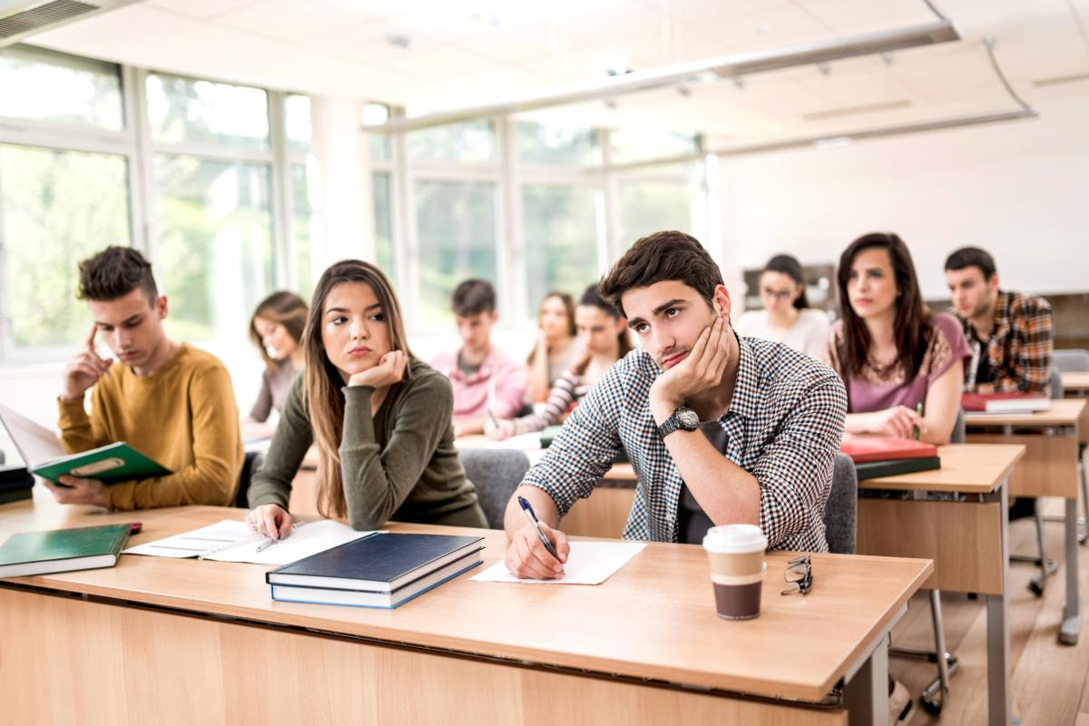
Class Attendance Taker:
Objective: From a photo of a class, find and identify the faces in the image.
Project elements:
Using custom Haar classifier from images of “students”, train model to identify students. Demo case, just using the four members of the group.
Using Media Pipe, find all possible faces in the class image.
Cut out ROI around each face
Identify the person from feeding in the ROI to the Haar classifier
Testing case:
Train model on team members
Take set of photos with some/all of the team members
Show that program can ID the team members

Slide 13
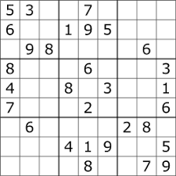
Soduku Puzzle Solver:
Objective: Take a picture of a Soduku puzzle. Read the number values. Program solves the puzzle (used 3rd party code). Display the solutions super-imposed on the original image.
Project elements:
Find edges and lines of the puzzle grid to define ROI boxes.
Use HOG classifier to ID numbers
Solve puzzle
Create image with solution in the right boxes
Testing case:
Printed out puzzles and took pictures to feed into program

Slide 14
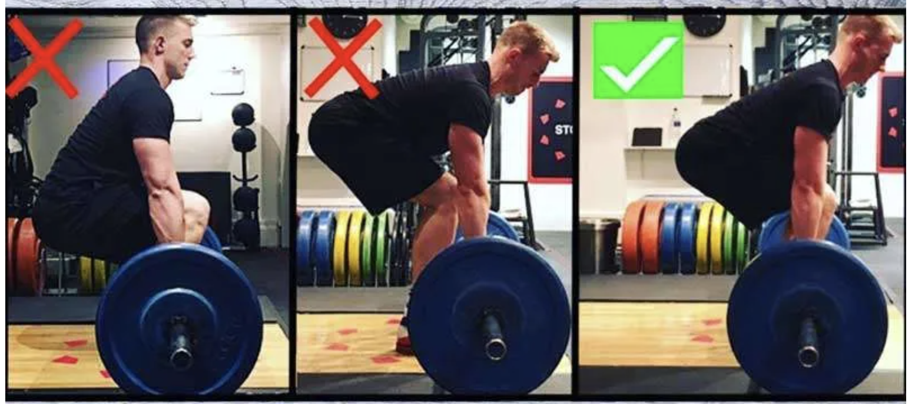
Lifting Form Feedback (2390):
Objective: From a video of a deadlift, calculate the position of the body parts and provide feedback on the correct form.
Project elements:
From a side view camera, find the location of the dumbbell (used Hough circles and segmentation)
Using OpenPose program (3rd part open source python code from CMU), find the location of the body parts and angles.
Testing case:
Took sample videos of a team member lifting weights with various technique.

Slide 15
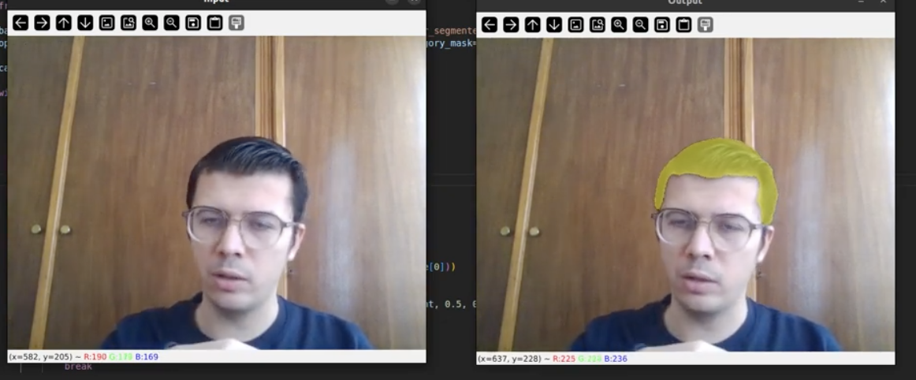
Virtual Hair Cut :
Objective: From a live web camera feed, find an image of a head, segment the hair and crop. Then replace the hair from one of several pre-defined styles
Project elements:
Video feed of single person “selfie” style image
Using media pipe for head and hair segmentation
Overlay predefined hair templates
Testing case:
Samples of various still and videos of faces.

Slide 16
Requirements:
Everyone
Written in Python using OpenCV
Code compliant with MIT use license
Documented and maintained on GitHub
Include demonstration/example code
ECE 1390 Students
Process still images
At least two methods described in class
Final presentation can be via PowerPoint showing features of program
ECE 2390 Students
Process video feeds
At least four methods described in class
Final presentation should include a live demo
Best practices for collaborative code via GitHub

Slide 17
Project “Investor” Pitch (Due 9/3/2025)
Each group will have 2 min to pitch their idea. (“elevator pitch”)
1 PowerPoint slide may be used (sent to Dr Huppert prior to class)
Class will have 5min to ask questions, make suggestions, get clarifications, etc. (think focus group feedback)

Slide 18
Project White page (Due 9/10/2024)
One-page white paper describing purpose and specs of your project.
Description.
Code Specifications.
Planned approach
Time-line
Metrics of success.
Pitfalls and alternative solutions

Slide 19
Yes, you can borrow code and methods.
With OpenCV and Python, you can find examples of virtually any code/project on the web.
However, I grading on whether you demonstrate that you understood it.
Requirements:
If you borrow code or use some tutorial to learn how to do the problem, then CITE IT!
Make the code your own. If you borrow code, then change variable names to be consistent with the rest of your code/library
Markup your notebooks and code with proper web-links
Implement best practices in coding
Names for variables/methods should be descriptive
Code should succinctly and clearly explain what it does.
Methods should document expected inputs/outputs/dependencies
Yes, it’s fine to comment (e.g.) “I don’t know why this flag is TRUE, but it doesn’t work otherwise”
Make sure someone else could read and understand your code
Use GitHub. Document changes, do pull requests, issue reports when needed.

Slide 20
Frequently asked questions
Can I do a video project even though I am enrolled in 1360?
Yes. You have to do the project requirements for 1360, but if you want to add the additional ability to do video or object tracking, you absolutely can.
I have a great idea of methods to add, but it wasn’t mentioned. Can I implement additional methods to my project?
Yes..

Slide 21
Frequently asked questions
What is your late work policy?
You can turn in homework late for half credit. To stay on schedule with the course and project, it is important to keep up with the schedule, but I know things come up. You need to turn in the work by the end of the semester.
What if I don’t finish the semester project?
If you keep up with the milestones, you shouldn’t have any problem finishing the minimum requirements, but you might not finish everything you planned to and wrote about in your white paper proposal of the project. In that case, I expect to see this documented on the white paper (which is part of the GitHub project).
I would rather you try too much and have to scale back, then to do the bare minimum.

Slide 22
Frequently asked questions
Can I work on a language other than Python?
No. I really expect this to be done in Python. Matlab’s version of OpenCV is very limited. If you have trouble with Python, there are many online resources, and we can help you in office hours.
What if I don’t know how to use GitHub?
- Part of developing software for a company is making sure that the code is documented and tracked for the next person to use. These are skills that I want you to learn (or improve) in this course.

Slide 23
Side note on licenses*
* It is a requirement of your projects that you pay attention to these
Permissive License
- Apache license (OpenCV)
- MIT license
- BSD license
Can distribute, modify, and distribute modified versions without royalty
Allows proprietization (you can use it as part of a more restrictive license)
Requires NOTICE file to be included in all derivatives
MIT requires statement of “As Is” and original copyright notice to be included in the documentation.
Copyleft
GPL license
AGPL license
Can distribute, modify, and distribute modified versions without royalty
No proprietization (derivatives must keep the same license as the original)
Requires NOTICE file to be included in all derivatives
Non-commercial
JRL license
AFPL license
Can only be used for non-commercial use
Public Domain
PD license
CC0 license
No restrictions at all
Proprietary
Can’t use!

Slide 24
Questions?

Slide 25
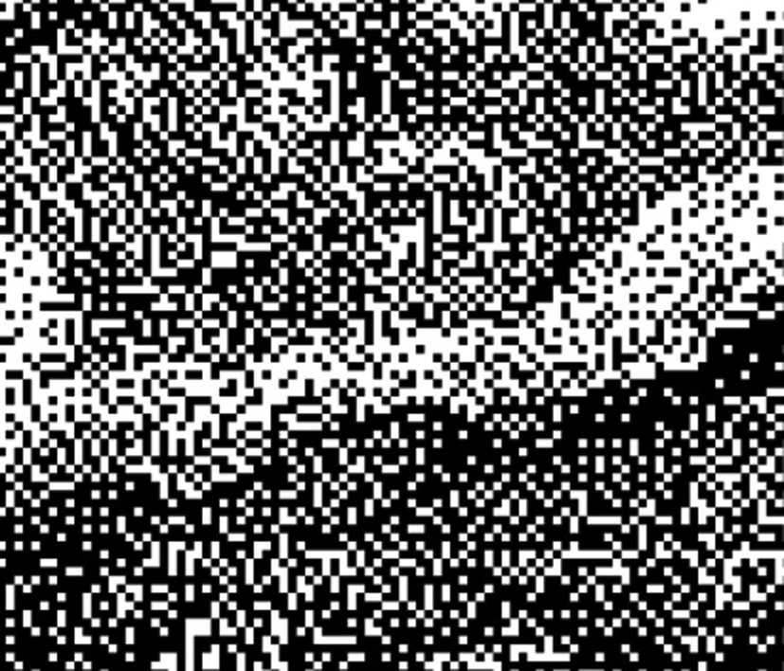
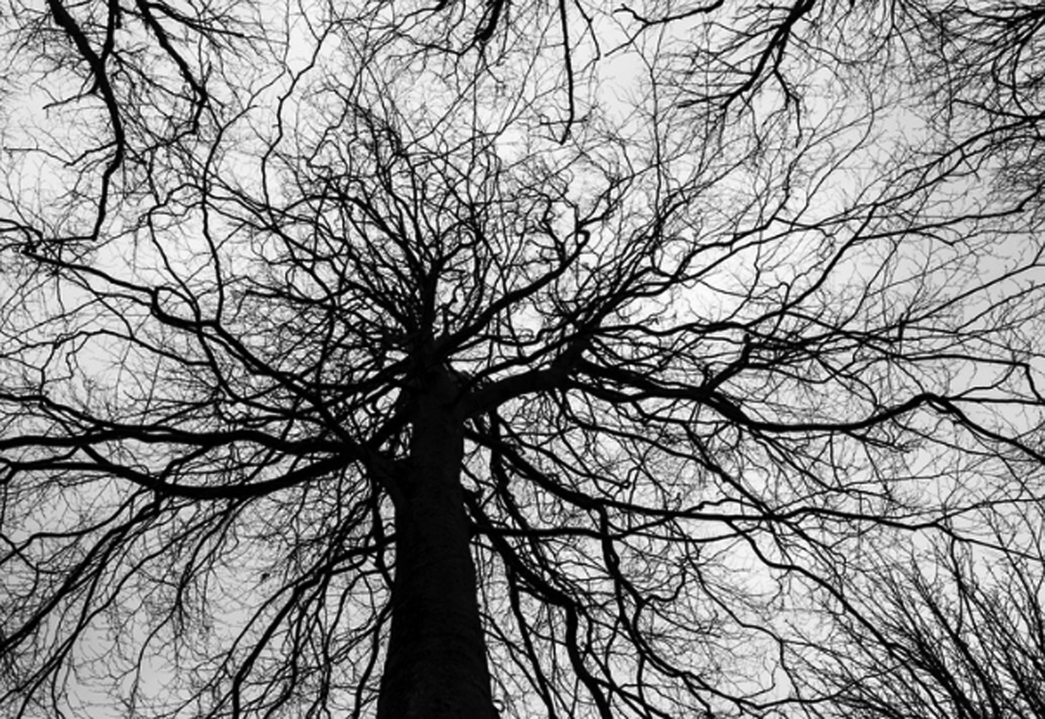
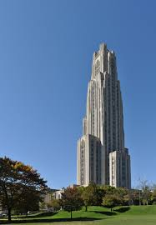
Types of Images
Binary
0 & 1
Used for masks
1-bit per pixel
Black & White image
0 & 1
At least 8bit per pixel
Display provides smoothness
Although Binary and B&W both encode the same information (only 1 & 0’s), the bit-depth changes how they are handled by display functions.

Slide 26
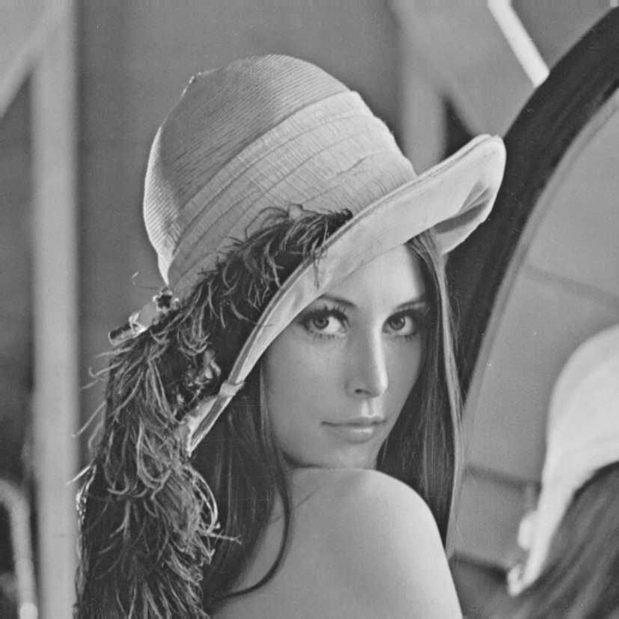
Types of Images
Greyscale
Pixel values across range
At least 8bit per pixel
One color channel
Color
Pixel values across range
At least 8bit per pixel
multiple color channels (typically 3 or 4)
Typically, the “alpha” channel

Slide 27
Glossary:
BPP: Bits per Pixel (bit depth)
Bits per Pixel (bpp) | Number of Colors
1 bpp | 2 colors
2 bpp | 4 colors
3 bpp | 8 colors
4 bpp | 16 colors
5 bpp | 32 colors
6 bpp | 64 colors
7 bpp | 128 colors
8 bpp | 256 colors
10 bpp | 1024 colors
16 bpp | 65,536 colors
24 bpp | 16,777,216 colors (16.7 million colors)
32 bpp | 4,294,967,296 colors (4294 million colors)
Bit value is an index! You always also need to define a color map (e.g. RGB, HSV, etc)

Slide 28
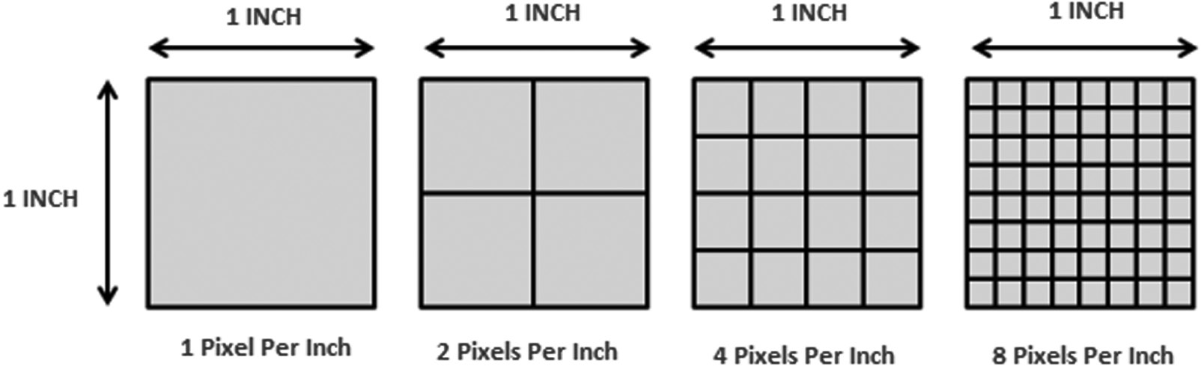
Glossary:
Pixel Density
Resolution
Bit more ambiguous of a term.
Sometimes:
total number of pixels ( e.g. 3Mpixels)
dimensions (e.g. 2556 x 1179)
PPI (e.g. 460ppi)
Pixels/degree (e.g. Apple RetinaTM display)
Humans can’t differentiate details beyond around 300 PPI

Slide 29
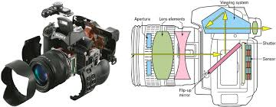
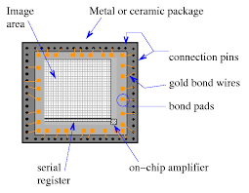
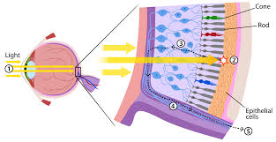
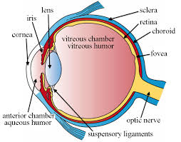
Glossary:
Resolution

Slide 30
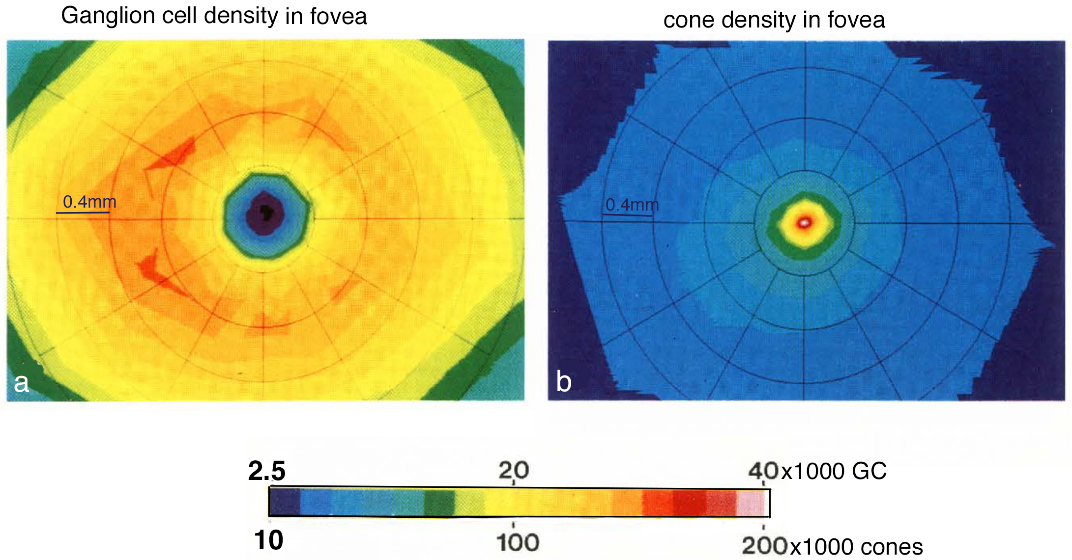
Glossary:
Resolution
From Curcio and Allen 1990
Visual acuity is highest at the center of the eye (fovea)
Here, the limit of the human eye is about 60 pixels / degree (1 arc-minute)
e.g. 3600 pixels (60 x 60) in a 1º x 1º area
Depends on distance from object

Slide 31
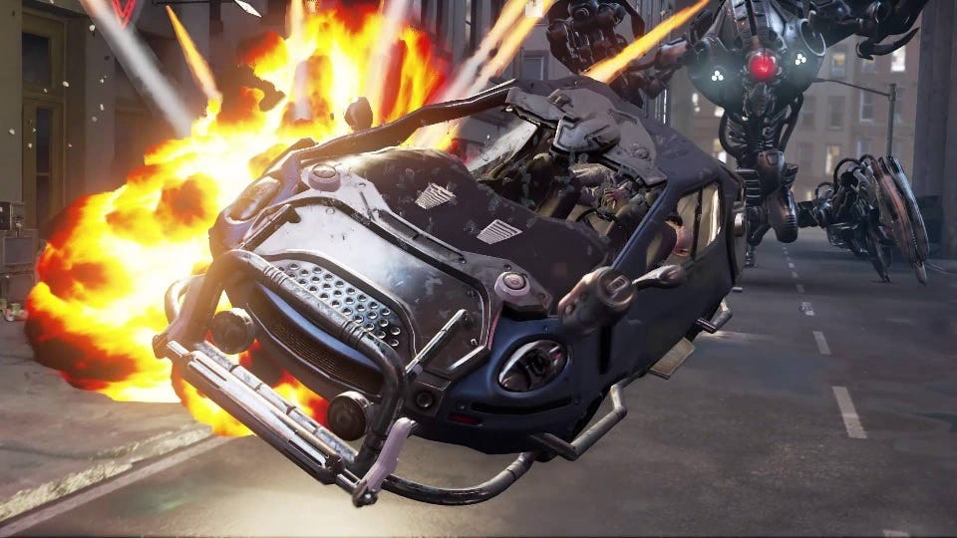


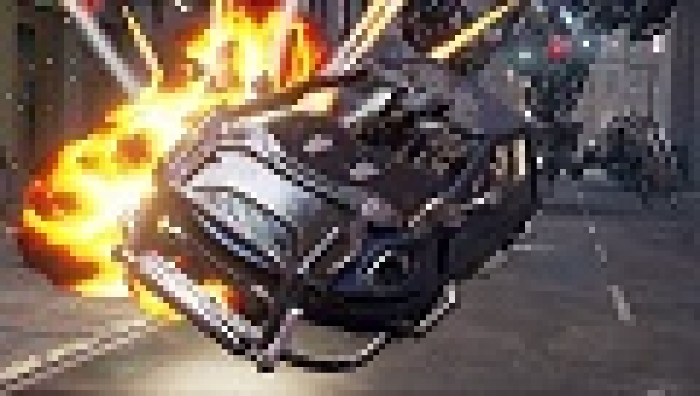
Glossary:
Resolution
60 px/degree
30 px/degree
15 px/degree
7.5 px/degree

Slide 32

Glossary:
Intensity
How large is the pixel value?
Brightness
How does the eye perceive intensity
Contrast
Range of intensities of pixels
Harder to differentiate
Easier to differentiate
Harder to differentiate
Gamma correction (and similar) designed to adjust intensity → brightness (next lecture)

Slide 33
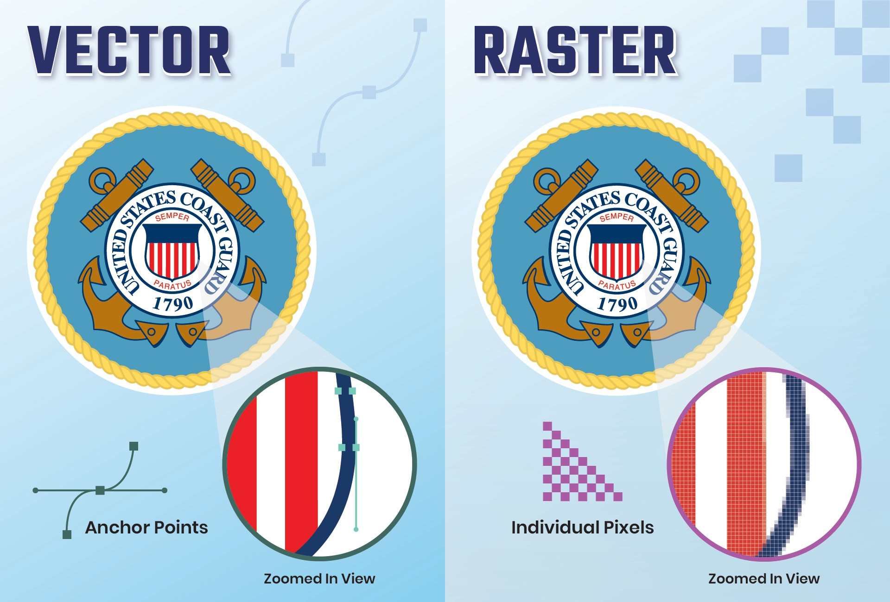
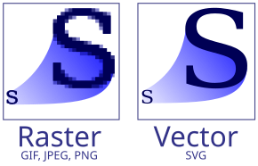
Raster images -Use pixels. -Lose information when resizing/zooming -E.g. JPEG, PNG, TIFF
Glossary:

Slide 34
Vector images -Define the image using piecewise formulas. -Lossless when resizing/zooming -Converted to raster for display -E.g. SVG, EPS, PDF, AI, PSD
Glossary:

Slide 35
Glossary:
Tiff (Tag Image File Format)
Raster image format
Most versatile for colors
Supports RGB, CMY, Grayscale, and more
Uncompressed (large file sizes, but lossless)
JPEG (Joint Photographic Experts Group)
Raster image format
Compressed image data (smaller size, but degradation)
GIF (Graphics Interchange Format)
Raster image format
Compressed color maps (smaller size, less color contrast)

Slide 36
OpenCV (https://opencv.org/)
Developed by Intel in 1999
Open-source (https://github.com/opencv)
Apache License 2
Features:
Image processing and visualization
Object recognition
Segmentation
Facial and gesture recognition
Image homography/registration
Depth perception
Deep learning methods
Code:
Written in C++
Bindings in Python, Java, Matlab
CUDA support (since 2010)
Currently version 4

